Slide 1


Are we able to predict upcoming traffic based on historical traffic and weather data?
Purpose
TomTom API
OpenWeatherMap API
Machine Learning
Prediction
Created by: Anton Ratush and Yaki Dror

Slide 2
Purpose
One of the most annoying issues we have in our modern world is traffic.
As we try to go to work, head back home or get to an important appointment, we need to take traffic time into consideration.
This results in us leaving way earlier than expected and hoping that we get on time from point A to point B.
Our goal is to predict the approximate travel-time from a specific start point to a specific end point, using Machine Learning.
We are also looking for additional factors, such as the travel-time, weather and departure times.
What Do we need?
We need to have a data-base which includes different factors that can potentially affect the travel-time.
Then, after analyzing the indexes we have, we can start working on the prediction via Machine Learning.

Slide 3
The Process
Data Acquisition
EDA
(Data exploration)
Machine Learning Modeling
Data Scrubbing
Scrape the web
to get data about
traffic information,
weather etc.
Format, clean and complete missing data
Visualization of different aspects of the data
Create a ML model to predict the approximate travel-time

Slide 4


Data Acquisition
Sources:
TomTom API
OpenWeatherMap API
TomTom
Using this API, we can get historical and
live data such as travel time, total
distance, departure time and arrival
time for every hour of any given time
OpenWeatherMap
Using this API, we can get historical data such as weather condition, temperature,
‘feels-like’ and much more

Slide 5
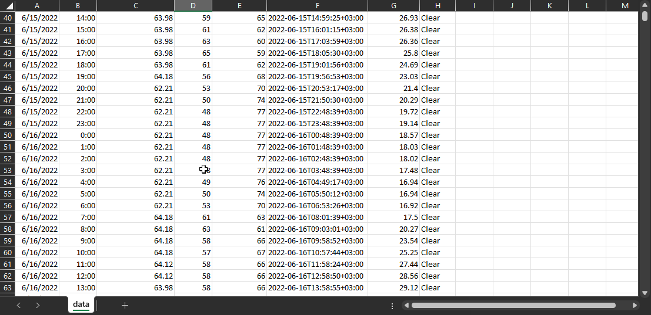
Data Acquisition - Process
Process
At first, we tried understanding how far do we have to actually go back in time in order to give the best calculation. We figured that two years is enough, but then found out that the OpenWeatherMap API allows us to pull information up to a year back.
We tried working with the APIs and noticed that when given a specific date, OpenWeatherMap outputs hourly information of that day (meaning 24 rows of data) while TomTom requires a specific hour aswell in order to give exact information.
After figuring a proper algorithm for requesting data from both APIs in one call, we ran the algorithm in a loop for 1 year (as we were limited), which sends over 8,700 requests to TomTom and 365 requests from OpenWeatherMap.
The algorithm also sets all the information to a CSV file, which in total included 69k indexes
We set a starting point at Central Jerusalem, while the finish point is at the Tel-Aviv beach
data.csv

Slide 6
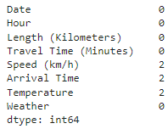
Data Scrubbing – Missing Data filling
How?
Although there weren’t many missing data (pulled from API), We’ve checked and found a couple of missing datasets. Due to this, we decided to fill the NAN values with Mean.

Slide 7
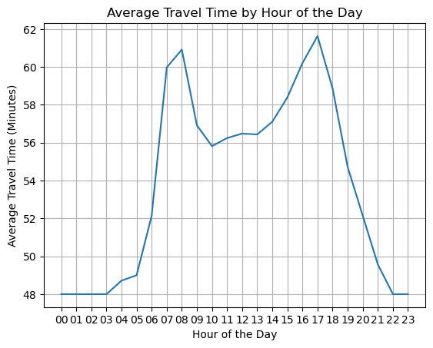
EDA – Travel-time per hours
The “busiest” hours are seen between 7:00 to 9:00 and between 14:00 and 18:00.
The “quietest” hours are between 20:00 and 06:00.

Slide 8
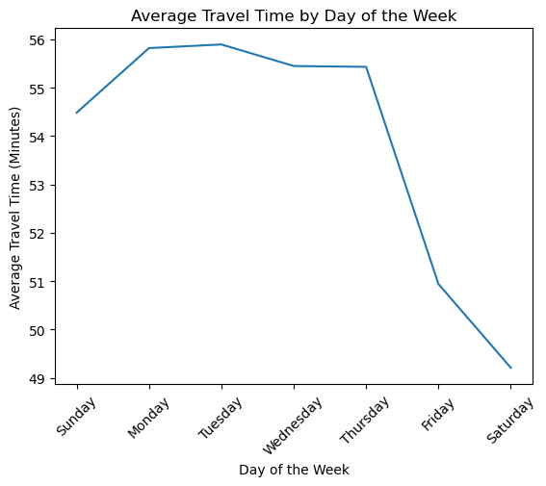
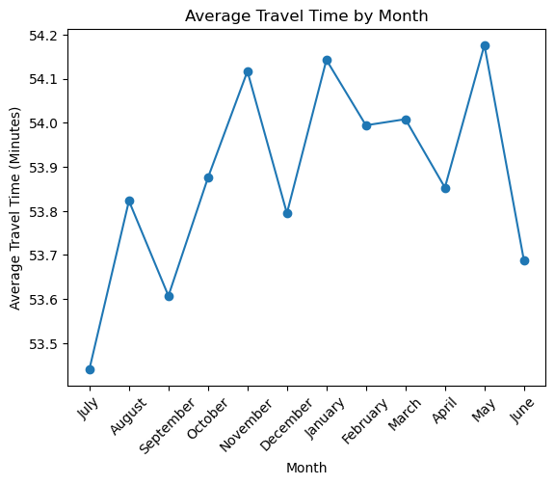
EDA – Travel-time per dates
“Busiest” days are Monday-Tuesday,
while the “calmest” is Saturday
“Busiest” months are November, January and May, while the “calmest” months are June-July.

Slide 9
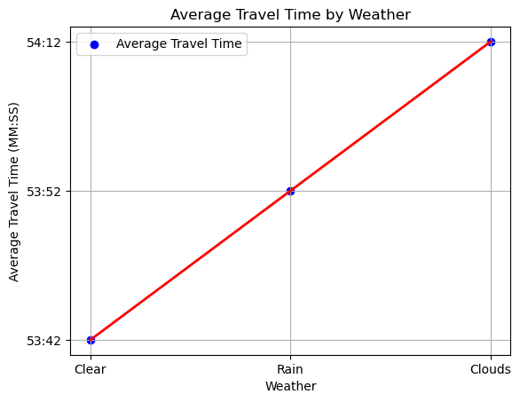
EDA – Travel-time per weather
We also noticed that the travel-time is affected by the weather condition. Although it doesn’t rain very much in Israel, the cloudy and rainy weathers cause a slight increase in travel-time as well.

Slide 10
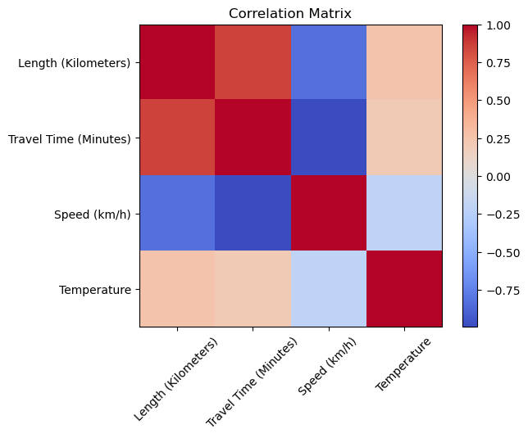
EDA – Correlation Matrix
Looking at the Correlation Matrix generated by the data, we can understand that there is some correlation between the temperature and the length/travel time as well.

Slide 11
Machine Learning
The goal
Create a model that can predict the approximate travel time, based on the data acquired.
The Method
Using an inputted date by the user, we use an algorithm that converts the date, checks what day of the week it is, checks the time and gets information from the database, modifies the calculation according to the weather, time of day and month – then prints out the predicted travel-time.

Slide 12


Machine Learning
Results
We have tweaked the script to make it as accurate as possible, and on most of the times, we were able to predict an accurate travel-time.
The results shown below are given from a day in the past using Machine Learning, and then we also requested from the TomTom API to provide us the actual travel-time, and we’ve compared them:
Overall accuracy:
To ensure our calculation was accurate, we have taken all the dates and times in our database, calculated it on our Machine Learning model, and compared it with the actual “travel-time” datasets that were given in the same database. Accuracy is 99.3%

Slide 13
Conclusions
Based on the analysis of historical traffic data and weather conditions, several patterns and correlations have been identified
regarding travel-time prediction from point A to point B.
The findings indicate that weather conditions, time of day and certain temporal factors significantly influence the travel-time.
Overall, these findings suggest that the prediction of traffic-time from point A to point B can be improved by
considering various factors such as weather conditions, time of day, and temporal trends.
Machine learning models can be trained using historical data to incorporate these correlations
and enhance the accuracy of travel-time predictions.

